Slide 1
Redesign
Report Training
USAS & USPS
11/1/2019

Slide 2
Basic Use of Report Manger
Helpful Date Shortcuts
Save and Recall
Report Direct Link
Job Scheduler
Report Bundles
Grid Reports
Modifying Reports
Creating a Custom Report
Financial Detail with Running Fund Balance
Agenda

Slide 3

Report Manger
Generate and Download
Open Report Definition in Detail Report View
Edit Name, description and tags
Delete Report Definition
Download Report Definition
Share Report definition with Roles
Favorite

Slide 4
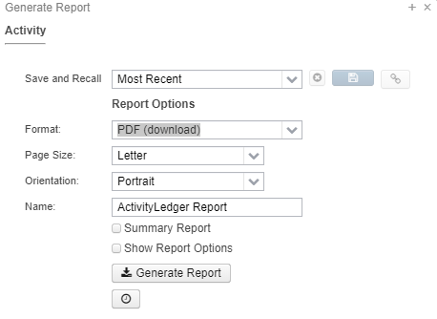
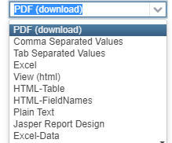
Generate and Download
Format: PDF, Excel, Plain Text, etc.
Page Size: Letter, Legal, etc.
Orientation: Landscape or Portrait
Name: You can change the name that will appear on the report if you do not want the default name.
Summary Report: This option will provide a simplified report with much less detail.
Show Report Options: This option will produce a page at the start of your report showing what Parameters were used.
When you click on Generate you will have several options to change the parameters for the report you are generating.

Slide 5

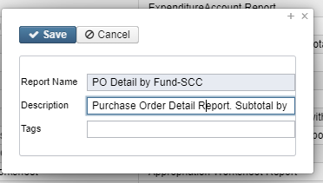
Open Report Definition
From here you can change the Properties of a report, Configure Filters, and Generate Report . We will cover this function later in the presentation.
Edit Name, description, and Tags
There are three fields:
Report Name: You are not able to modify this field.
Description: Brief information about the report.
Tags::Tags are user-defined words that mean something to the user to help categorize report definitions. For example, a tag could be 'YEAREND' or 'MONTHLY' reports. Then they can use these tags for several other reports , enabling them to search for them easily in the Grid.

Slide 6

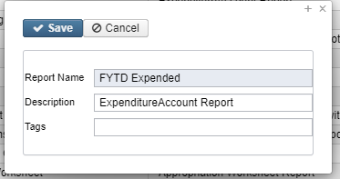
Deleting Report Definition
This button will delete a report for all users from the system.
SSDT Reports cannot be deleted.
Be careful deleting reports. There is no “undo”. If deleted a report will have to be recreated or reimported if you have the JSON
Download Report Definition
If you want to share a report with another district. Clicking this button will cause a JSON file of the report definitions to download. You can then email this file. Do not open it.
Importing Report
Click on “Import Report” button on the left side of the screen. Find the JSON on your device and select it. Redesign will tell you if the import is successful or not. Click Save on the box that will appear on your screen.

Slide 7
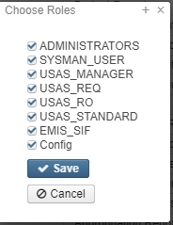
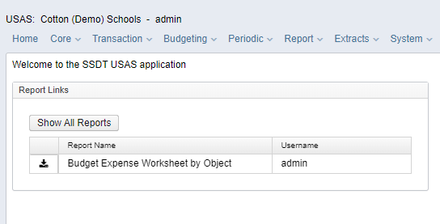
Share Report Definition with Roles
This button will give you the option to choose what users can see and use the report.
This will only be an option if you are the user that has created the report. Otherwise it will be greyed out.
Favorite
When you click the box that report will appear on your Home screen under report links. By unclicking the box the report will no longer appear on you home screen under report links.

Slide 8
Helpful
Date Shortcuts
YeaR (Calendar)
Y - January 1st of current year 1/1/19
R - December 31 of current year 12/31/19
FiscaL
F - 1st day of current fiscal start date 7/1/19
L - Last day of current fiscal end date 6/30/20
MontH (based on current system date)
M - 1st day of current month 4/1/19
H - Last day of current month 4/30/19
WeeK
W - 15th day of current month 4/15/19
K - Saturday of current week 4/21/19
PerioD (Posting Period)
P - 1st day of next month 5/1/19
D - Last day of next month 5/31/19
Quarter
Q - 1st day of current quarter 4/1/19
U - Current date 4/18/19
Quarter
Q - 1st day of the current quarter 04/01/2019
R - Last day of the current quarter 06/30/2019
T - today
+ Tomorrow's date 4/19/19
- Yesterday's date 4/17/19
Many of the grid queries, entry screens and reports allow for a date or date range to be entered. For example, you can use the beginning and ending characters to indicate the beginning and ending dates for the current applicable period. Please note these aren't case-sensitive:
Examples: The following are the list of letters/symbols used and its meaning (letters are NOT case sensitive):

Slide 9

Save and Recall
For the save button to become available you need to type in a something into the “Save and Recall” field.
After you save the next time you Generate a report you can click on the drop arrow to recall the save report.
This is handy if you want to generate the same report with different parameters.

Slide 10
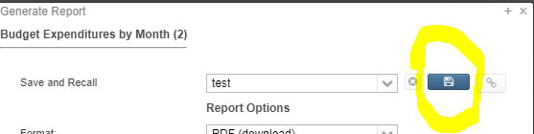

Report Direct Link
The Show Report Link icon will become available for any report parameters saved via the Save and Recall option. To use “Save and Recall” you need to enter information into the field. The icon will open a window containing a direct hyperlink to execute the report. The link may be bookmarked, sent via email, placed on a web page, etc.
Save & Recall

Slide 11
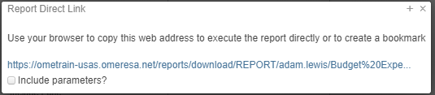
Report Direct Link Continued
Include Parameters?: This checkbox can be used to include all of the current parameters in the report link. When used, the report link will always use the original saved parameters. If this is not checked, the report link data will be run with the currently saved parameters for the Save and Recall name. If the saved parameters are changed and saved, the changes will affect future invocations of the link.
A Few Notes:
A username is required to access the report via direct link.
The report direct link can be shared with other users. Each user will be required to login with their USAS-R credentials when the report link is accessed.

Slide 12
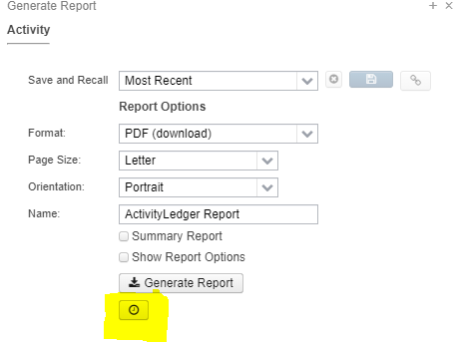
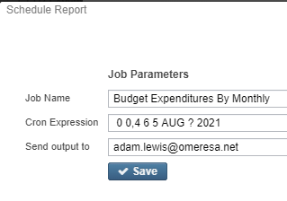
Job Scheduler
Job Scheduler allows users to create “Jobs that can run a report with specified parameters on a schedule.
When you click on “Generate” on Report Manger you can click on the at the bottom of the page.
The next screen will let you name the job, create a “Cron Expression” as to when the job will run, and to where the job will be sent once it is completed. If you do not input an expression the job will run immediately.

Slide 13
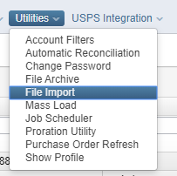
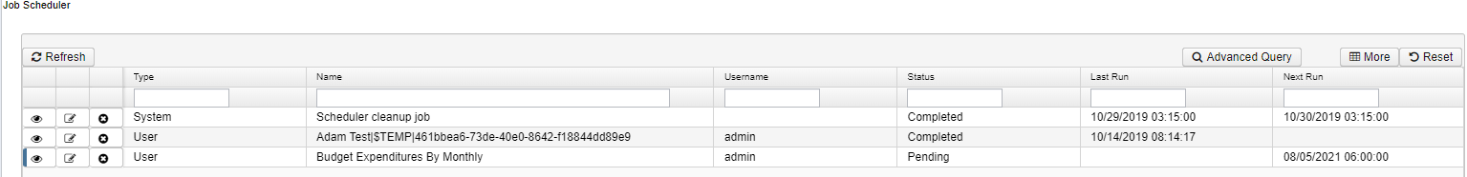
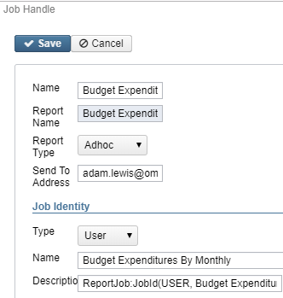
Job Scheduler Continued
To view jobs that have been scheduled go to
Utilities > Job Scheduler
On this screen you can see:
Scheduled Job
Who created them.
A Description
Status
Last Run
Next Run
You are also able to deleted a modify some fields and delete a job.

Slide 14
Helpful Links to Find or Build Cron Expressions
https://www.freeformatter.com/
cron-expression-generator-quartz.html

Slide 15

Report Bundles
To create a Report Bundle go to Report > Report Bundles
On this page you can create report bundles and see bundles that have already been created.
Click Create

Slide 16
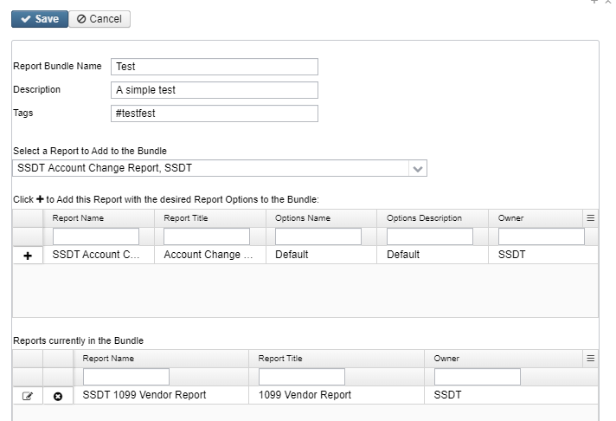
Report Bundles Continued
After clicking on create you will need to enter a “Report Bundle Name”.
“Description” and “Tags” are optional fields you can use to help filter bundles.
Once you select a report from the drop down it will then appear in the first grid. To add it to the bundle you must click the
When you click the the report will appear in the second grid. Only reports showing in the second grid will be included in the bundle.
Once a report is in the second grid you can then edit the report options. You can also delete a report by click on the delete button next to the report name.

Slide 17
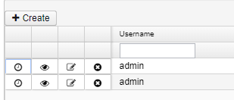
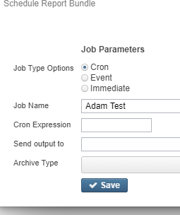
Report Bundles Continued
After you click save the newly created report bundle will appear in the
Report Bundle Manger grid. From the grid you have the options to “Set Scheduled”, “View”, “Edit”, and “Delete” the report bundle.
When scheduling a report bundle you have a few options.
Job Type:
Cron – You will need to enter a Cron Expression
Event – For example org.ssdt_ohio.usas.model.fiscalPeriod.FiscalPeriodCloseEvent can be used to send a report bundle at the close of the fiscal year.
Immediate – The bundle will run and send now.
You can view scheduled jobs under Utilities > Job Scheduler

Slide 18

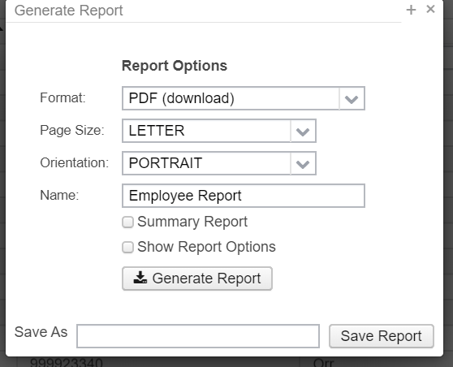
Grid Reports
You are able to generate reports form any “Grids”
On the right side of the page you can click on the Report button.
This will give you the option to generate a report with the columns currently shown.
You can add columns by click the More button to the right of Report. This will let you add items.

Slide 19
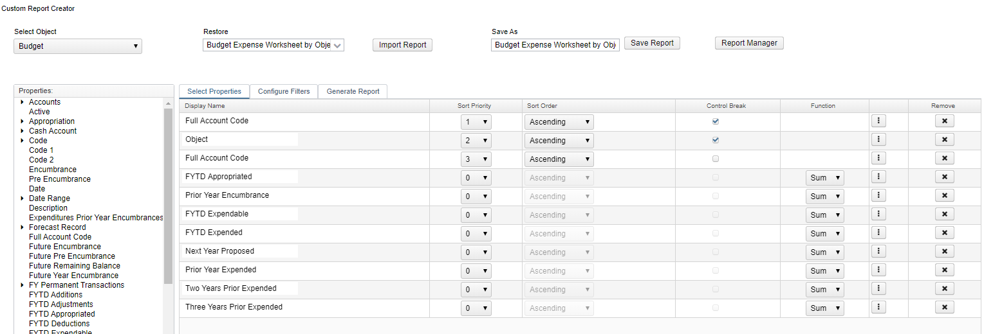
Modifying
Reports
You are able to modify any reports under Report > Report Manger
You cannot modify reports that appear under the Report tab dropdown.

Slide 20
Selected Properties
Reportable properties are available for nearly all possible related data types. The properties within those related data types are represented in an expandable tree format. Properties are selected by either double clicking on the properties on the left or drag and drop them into the box on the right. Once the user has selected the desired properties, they can order them in the box on the right as they wish the columns to appear on the report by drag and drop. Properties may be removed by clicking on the remove button beside the property. Within the properties selected, the user will need to determine how to sort the report. Sorting is accomplished by choosing a number under the Sort Priority column. In order to control break or page break by a property it must first be assigned a sort priority.

Slide 21
Customize Properties
  For each property, the user may customize the following:
    Sort Priority: the order in which the report will be sorted
    Sort Order: sort the property in ascending (lowest to highest) or descending order
    Control Break: if the property changes, it will bold the change. For example if you run a budget report and sort/control break on the fund every time there is a new fund it will bold the fund number.
    Note: You must assign a sort priority first when using this.
    Function: available on a numeric property which will allow the user to get subtotals, average, min or max
    Set Extended Properties: ability to modify several details of the template report.
    Remove: removes the property from the report.

Slide 22
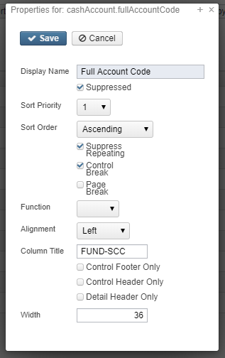
Extended Properties
Suppressed: if the box is check marked, the property will not appear on the report. This is useful if the user selects a property for control break purposes but does not want it to appear on each detail line of the report.
Sort Priority: available on the 'select properties' menu but can also be changed from the set extended properties menu.
Sort Order: available on the 'select properties' menu but can also be changed from the set extended properties menu.
Suppress Repeating: repeating properties will not appear on the report.
Control Break: available on the select properties' menu but can also be changed from the set extended properties menu

Slide 23
Extended Properties Continued
Page Break: advance to the next page when the property value changes
Function: available on the 'select properties' menu but can also be changed in the set extended properties menu
Alignment: choose from left, right, center or justified
Column title: customize the default column title
Control Header Only: Checkmark if the property should appear in the control header instead of as a column on the report.
Detail Header Only: Checkmark if the property should appear in the detail header instead of as a column on the report
Width: change the width of the column

Slide 24
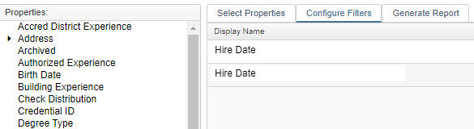


Configure Filters
You will select Properties you want to filter the report on. It does not have to be a property you included on the report.
Properties to filter on are selected by either double clicking on the properties on the left or drag and drop them into the 'Display Name' column.
Select the desired operation. Example Equals, Like, ect.
Filters can be a specified value. Example a date.
Filters can also be set as a “parameter value”. Once a parameter is set up the user is prompted to enter a value when generating a report.

Slide 25


Generate Report and Save Report
You can test your changes by using the Generate Report Tab
Once you are satisfied you can click “Save Report”.
You are able to change the name of the report here when you save it.
If you do not change the name of the report you will overwrite the old report if you are the person who created the report. If you did not create the report that is being modified then a new report will be created with the same name.
After saving a report it can then be found in the Report Manger.

Slide 26

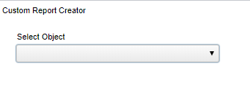
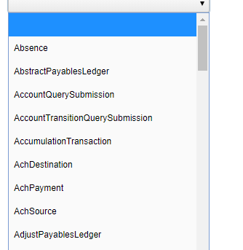
Creating a Custom Report
Go to Reports > Custom Report Creator
You will need to “Select Object. Available Objects are listed in the Select Object Drop-down.
You want to choose the most appropriate Object for your desired report.

Slide 27
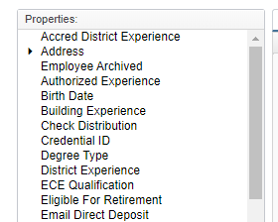
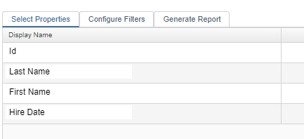
Creating a Custom Report - Properties
Report-able properties are available for nearly all possible related data types.
The properties within those related data types are represented in an expandable tree format.
Properties are selected by either double clicking on the properties on the left or drag and drop them into the box on the right.
Once the user has selected the desired properties, they can order them in the box on the right as they wish the columns to appear on the report by drag and drop.

Slide 28
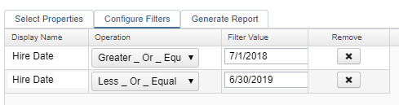
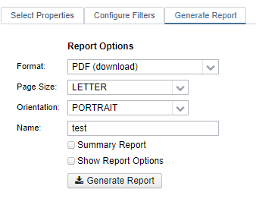
Custom Reports – Filters
Allows the user to include or exclude specific properties within the object.
For example when selecting the ‘Hire Date' and the user only wants to see the employees hired from 07/01/2018 to 6/30/2019 they can use the configure filter screen to include only employees for that time period.
With your properties and filters now set you will want to click on the “Generate Report to test your report.

Slide 29
Financial Detail with Running Fund Balance
https://wiki.ssdt-ohio.org/display/usasrdoc/Create+Financial+Detail+Spreadsheet+with+Running+Fund+Balance
&
https://helpdesk.omeresa.net/helpspot/admin.php?pg=kb.page&page=1449

Slide 30
THANK YOU!
OME-RESA Fiscal Staff
Phone
740-283-2050 x 700
Email
fstaffr@omeresa.net

